Slide 1
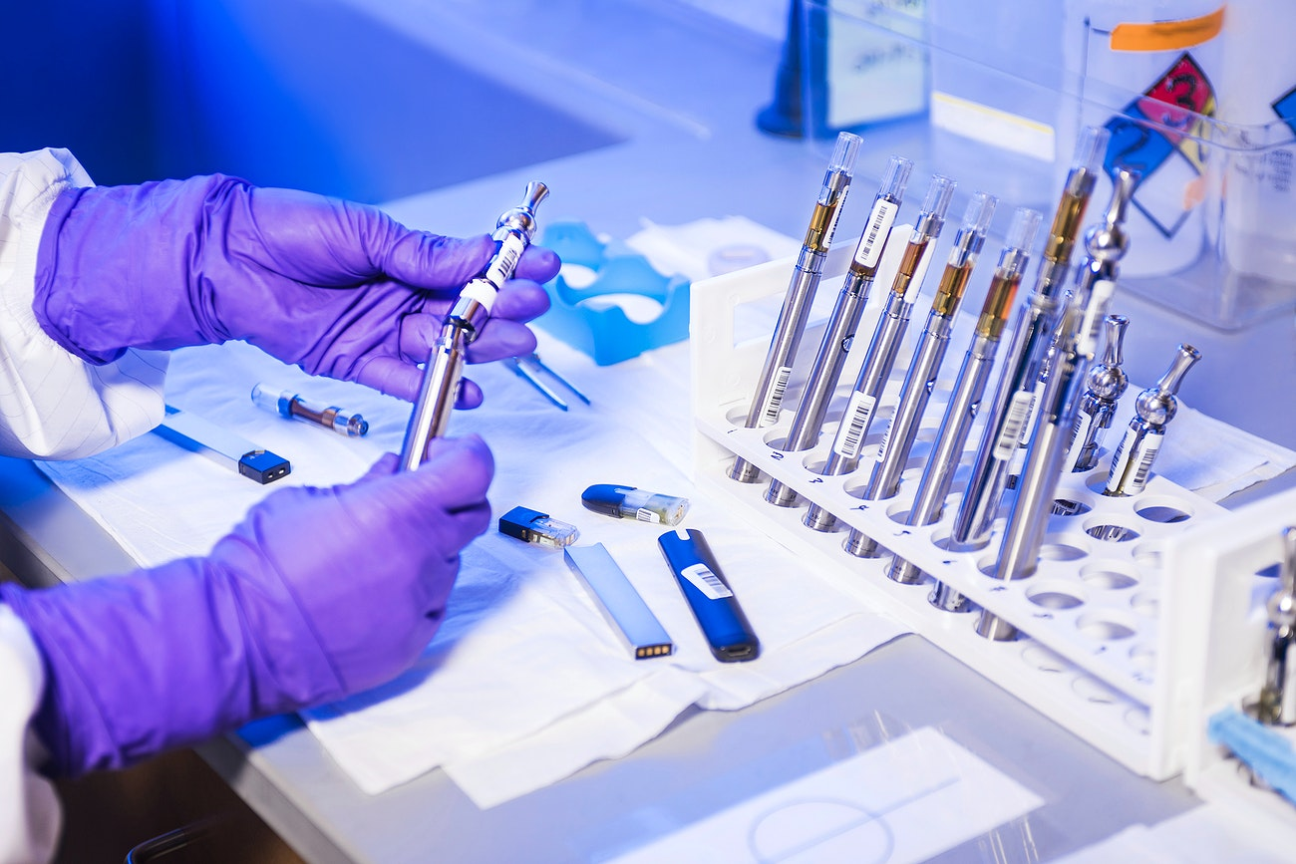

MANY LABS®
WHY SHOULD YOU USE THE APPLICATION?

Slide 2
VANTAGES
Careful Design of the Application
User-First Approach
Practical and Intuitive Interface
Existence of an User Manual
All the requirements were followed

Slide 3
CREDITS
Luís Ribeiro (1201184@isep.ipp.pt)
Pedro Graça (1201188@isep.ipp.pt)
Miguel Ramos (1201247@isep.ipp.pt)
André Soares (1201314@isep.ipp.pt)

